Slide 1
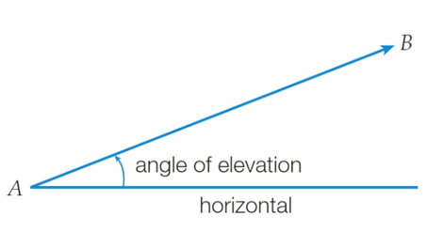
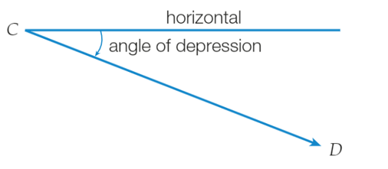
Angles of elevation and angles of depression
The angle of elevation from A to B is the angle between the line AB and the horizontal.
If you were positioned at A, you would need to raise your eyes from a horizontal line of sight to view an object at B.
The angle of depression from C to D is the angle between the line CD and the horizontal.
If you were positioned at C, you would need to lower your eyes from a horizontal line of sight to view an object at D.
Elevation: look up.
Depression: look down.

Slide 2
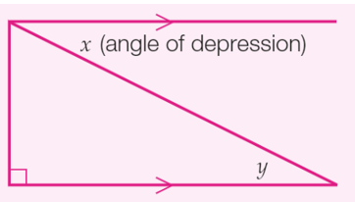
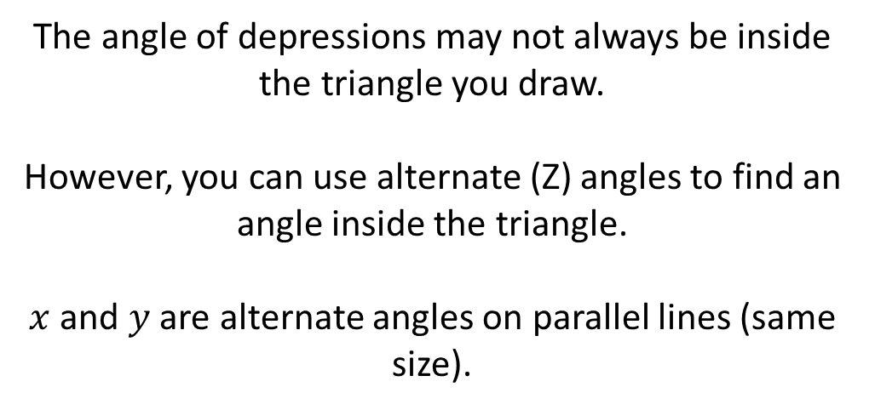
Angles of elevation and angles of depression
Elevation: look up.
Depression: look down.
The angle of depressions may not always be inside the triangle you draw.
However, you can use alternate (Z) angles to find an angle inside the triangle.
$x$ and $y$ are alternate angles on parallel lines (same size).

Slide 3





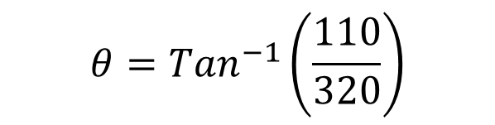
Angles of elevation and angles of depression
Reminders:
Step 1: Draw a diagram from the picture or worded description. Step 2: Label and decide which ratio to use. Step 3: Calculate the unknown.
A swimmer, 320 m from the base of a cliff, looks up and waves to her friend who is at the top of the 110 m cliff.
Find the angle of elevation from the swimmer to the top of the cliff.
$$Tan θ= \frac{O}{A}$$
T A N
O
H
$$Tan θ= \frac{110}{320}$$
110 m
$$θ={Tan}^{−1}\left(\frac{110}{320}\right)$$
Ɵ
$$θ=18.9704…$$
320 m
A
The angle of elevation is 19°.

Slide 4
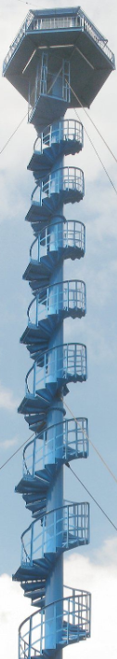
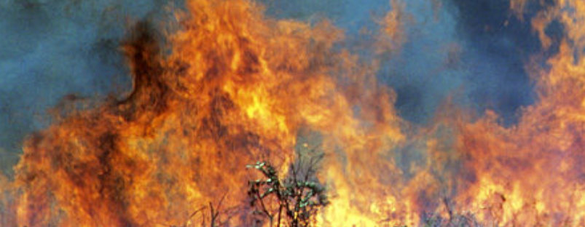





Angles of elevation and angles of depression
Reminders:
Step 1: Draw a diagram from the picture or worded description. Step 2: Label and decide which ratio to use. Step 3: Calculate the unknown.
A ranger at the top of a lookout spots a small fire at an angle of depression of 12.5°.
If the tower is 76 m high, what is the distance from the base of the lookout to the fire.
$$Tan θ= \frac{O}{A}$$
T A N
12.5°
$$Tan 12.5°= \frac{76}{x}$$
O
H
76 m
$$x=\frac{76}{Tan 12.5°}$$
12.5°
$$x=342.8138…$$
A
$$x$$
The distance is 343 m.

Slide 5
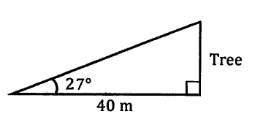



Angles of elevation and angles of depression
Reminders:
Step 1: Draw a diagram from the picture or worded description. Step 2: Label and decide which ratio to use. Step 3: Calculate the unknown.
From a point on level ground, 40 metres from a tree, the angle of elevation to the top of the tree is 27°. Calculate the height of the tree.
$$Tan θ= \frac{O}{A}$$
T A N
$$Tan 27°= \frac{x}{40}$$
$$x=40×Tan 27°$$
$$x=20.381…$$
The tree is approximately 20 m tall.

Slide 6
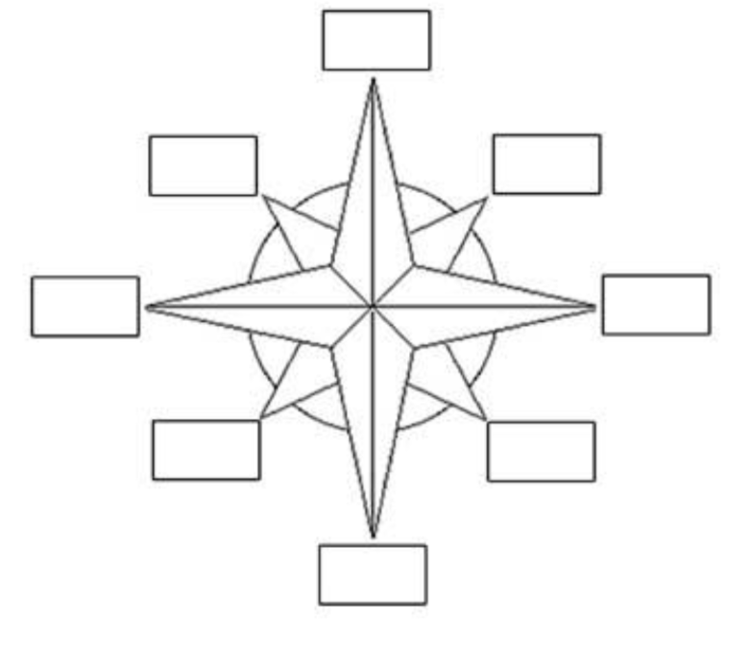
Bearings – true and compass
The 4 directions on a compass are:
North
West
East
South
These can be remembered as Never “Eat Soggy Weetbix” or Never Eat Slimy Worms

Slide 7
Bearings – true and compass
In between the 4 directions on a compass are:
North
N West
N East
West
East
S West
S East
South
Note: The ‘N’ and ‘S’ come before the East and West

Slide 8
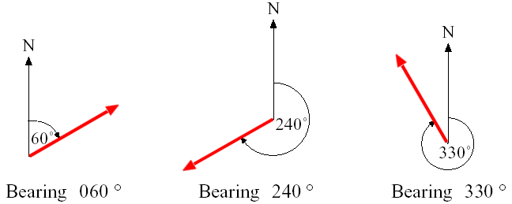
Bearings – true and compass
True bearings give the angle in a clockwise direction from North
B
A
The True bearing of B from A is 060°T
True bearings are always written with three digits so it is 060°T

Slide 9
Bearings – true and compass
True bearings give the angle in a clockwise direction from North
A
B
The true bearing of B from A is 240°T
True bearings are always written with three digits so it is 240°T

Slide 10
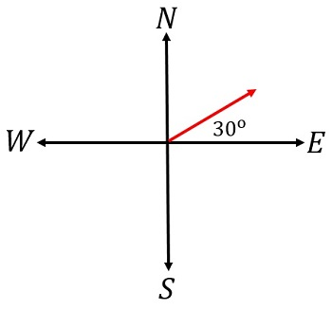
Bearings – true and compass
Compass bearings give the angle:
Which starts from the North or South (whichever is closer) – N
Which moves to the East or West (whichever is closer) - E
The compass direction is North-East 60 °
The compass bearing is N60°E

Slide 11
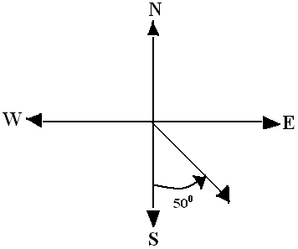
Bearings – true and compass
Compass bearings give the angle:
Which starts from the North or South (whichever is closer) – S
Which moves to the East or West (whichever is closer) - E
The compass direction is South-East 50°
The compass bearing is S50°E

Slide 12
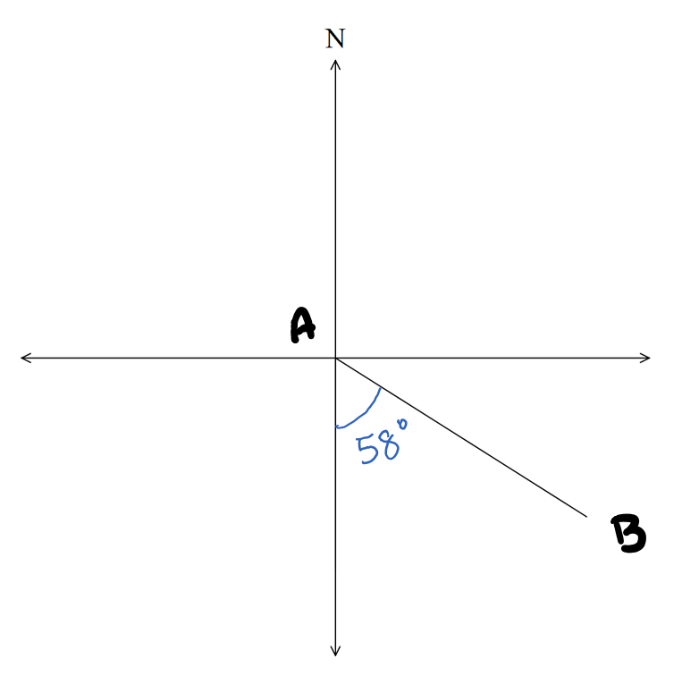
Bearings – true and compass
Determine the
Compass bearing
True bearing
The compass bearing is S58°E
The true bearing is $180−58=122°T$

Slide 13
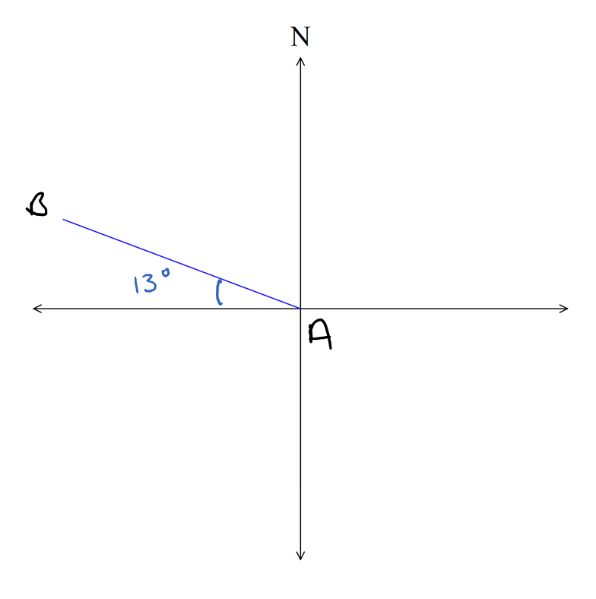
Bearings – true and compass
Determine the
Compass bearing
True bearing
The compass bearing is N77°W
The true bearing is $270+13=283°T$

Slide 14
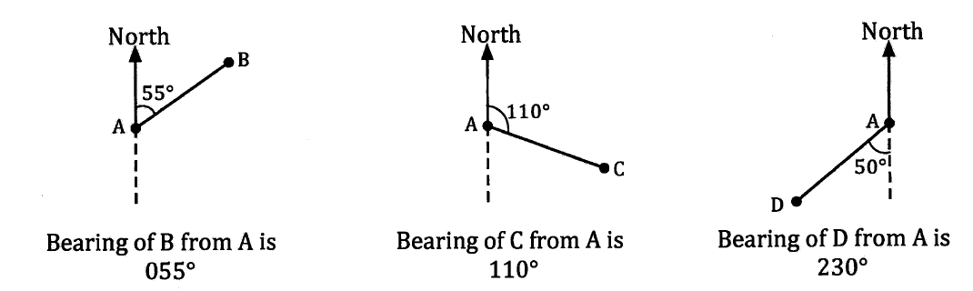
Bearings – true and compass
A bearing can be described as the direction we would need to travel from one location to reach a 2nd location. These are angles, expressed as three figures, and are measured clockwise from North (for true bearings).
Compass bearing of B from A is N55°E
Compass bearing of B from A is S70°E
Compass bearing of B from A is S50°W

Slide 15
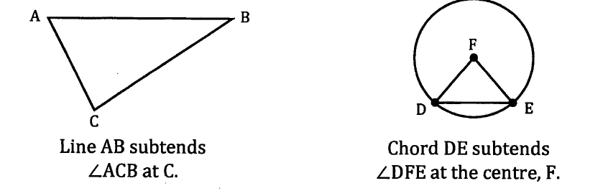
Vocabulary
If a question talks about a line subtending an angle at a point, this is the angle formed by joining each end of the line to the point.

Slide 16
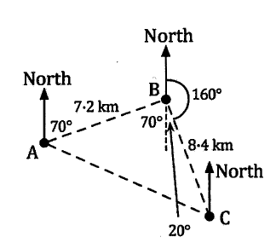


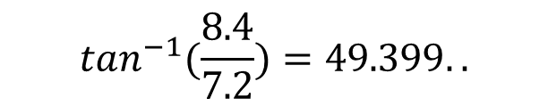




Bearings – true and compass
Now do exercise 10B
Town B lies 7.2 km away from town A, on a bearing of 070°T. Town C lies 8.4 km away from town B, on a bearing of 160°T. Find the distance and bearing of town C from town A.
Using alternate angles and supplementary angles, we
Know that $<ABC=90°$ (70 + 20) so $∆ABC$is right angled.
$$\tan{x= \frac{8.4}{7.2}}$$
$${AC}^{2}={7.2}^{2}+{8.4}^{2}$$
$${AC}^{2}=122.4$$
$$\tan^{−1}(\frac{8.4}{7.2}){=49.399..}$$
11.1 km
$$AC≈11.063 km$$
$$x{≈49.4°}$$
Town C is approximately 11.1 km away from town A, on a bearing of 119°T (70 + 49).

